Slide 1
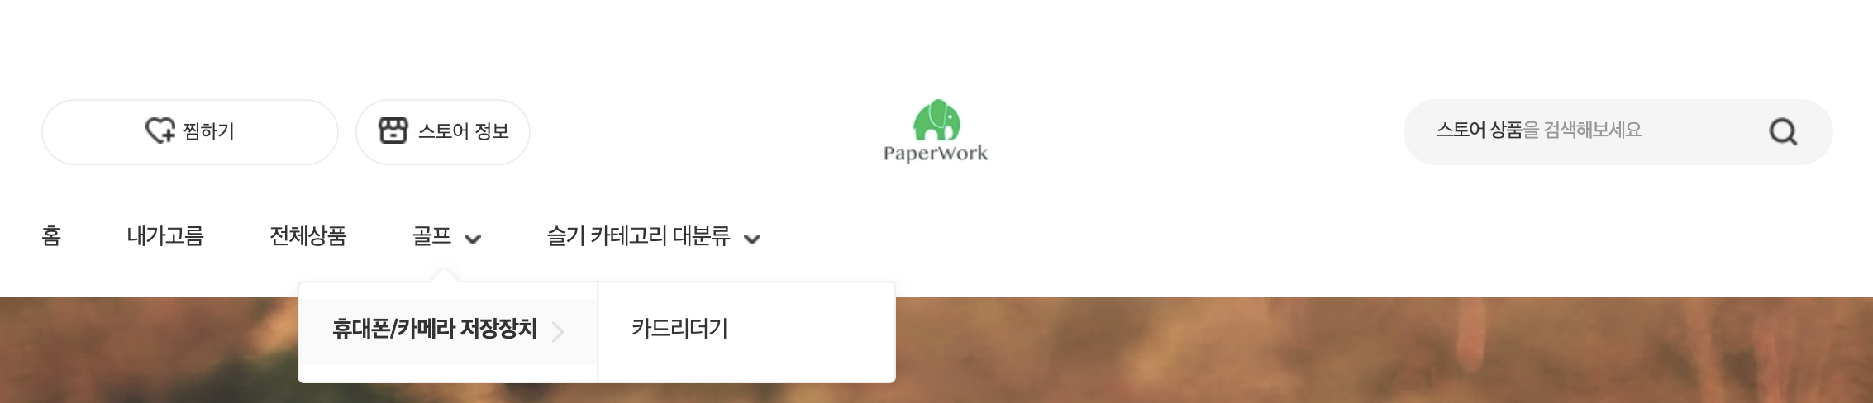
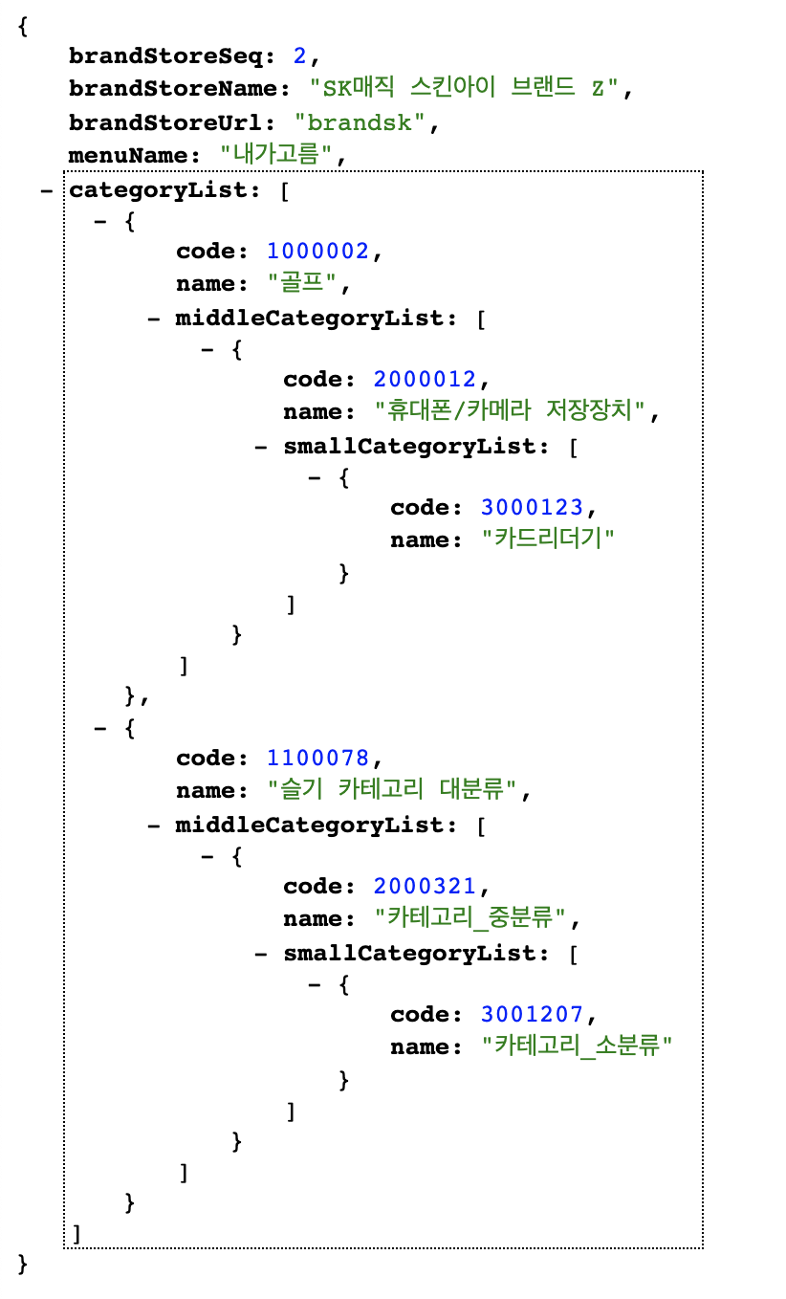
Header
API: https://front-qa.wemakeprice.com/api/listingsearch/v1.0/brandStore/category/all.json?brandStoreSeq={brandStoreSeq}
EX: https://front-qa.wemakeprice.com/api/listingsearch/v1.0/brandStore/category/all.json?brandStoreSeq=2
1.
2.
1.
2.

Slide 2
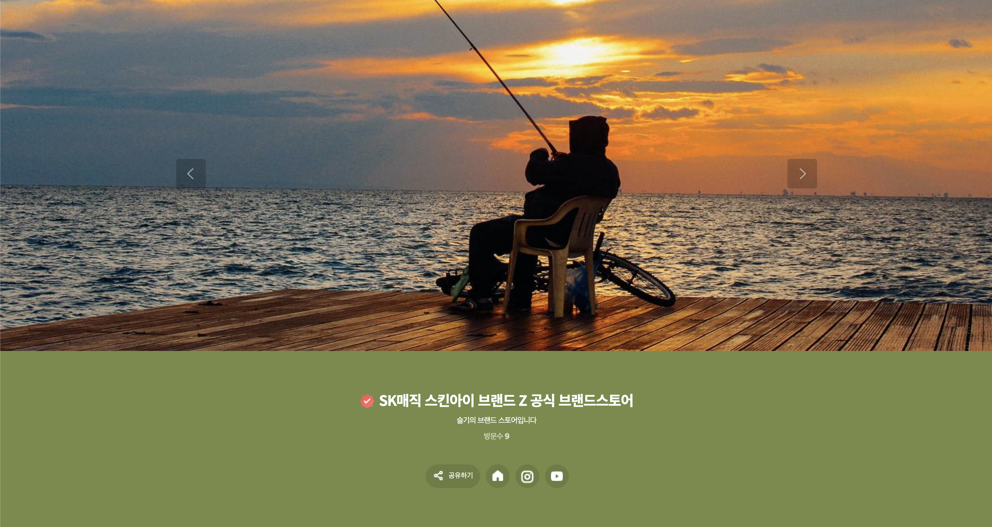
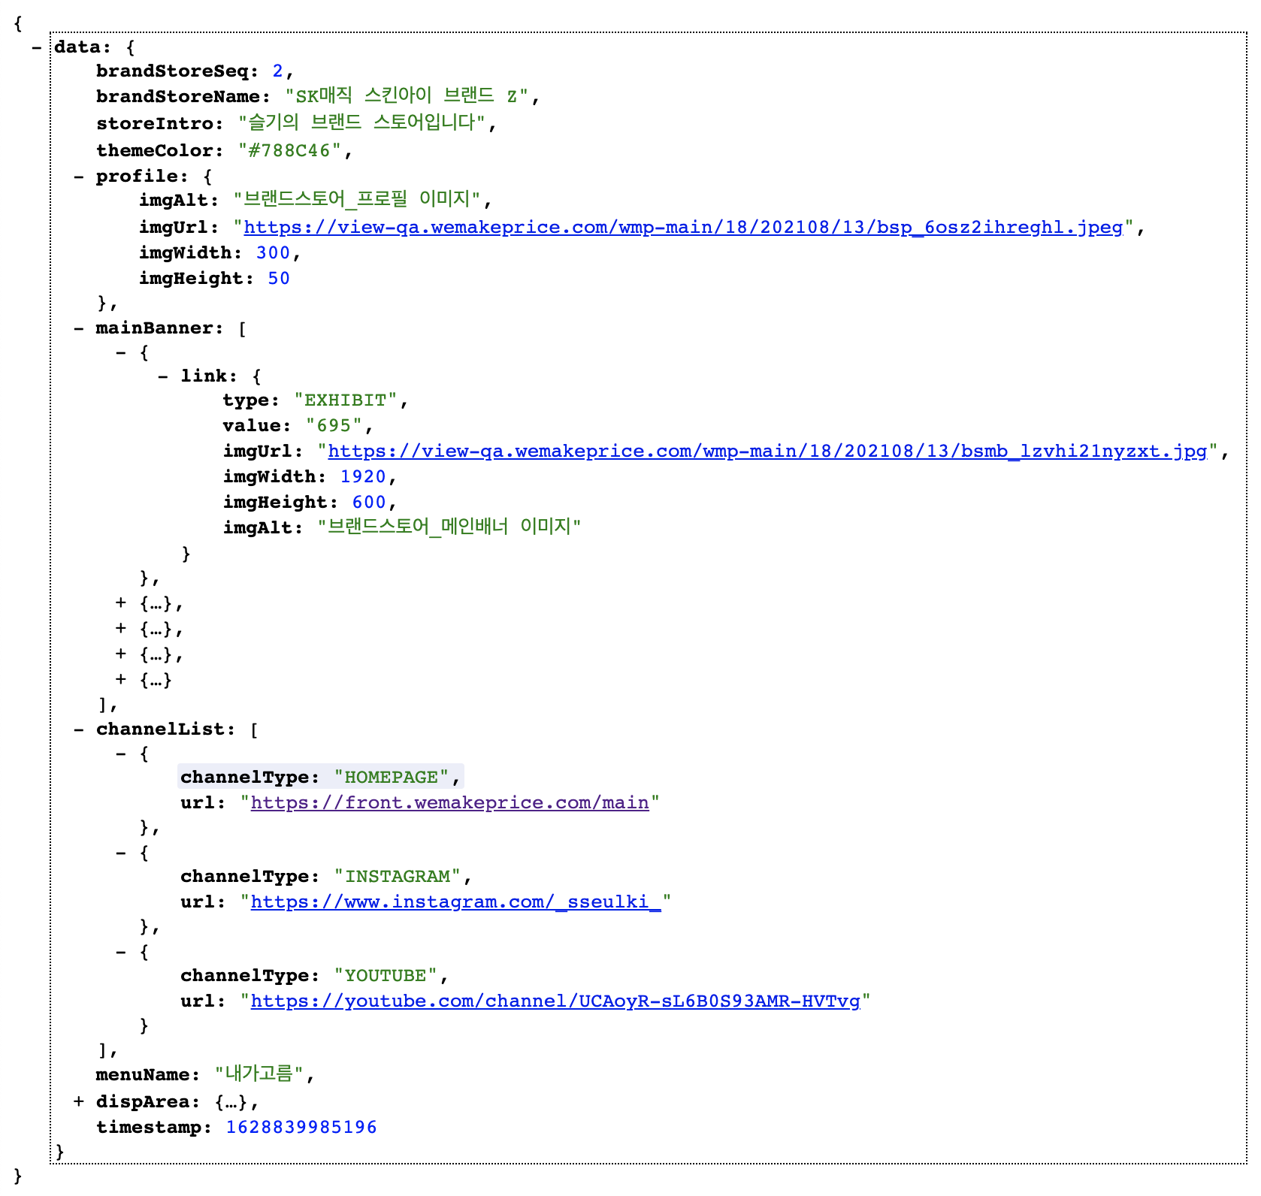
Home (메인 배너)
API: https://front-qa.wemakeprice.com/api/front/brandStore/main/{brandStoreUrl}.json
EX: https://front-qa.wemakeprice.com/api/front/brandStore/main/brandsk.json
3.
1.
2.
3.
4.
1.
2.
4.

Slide 3
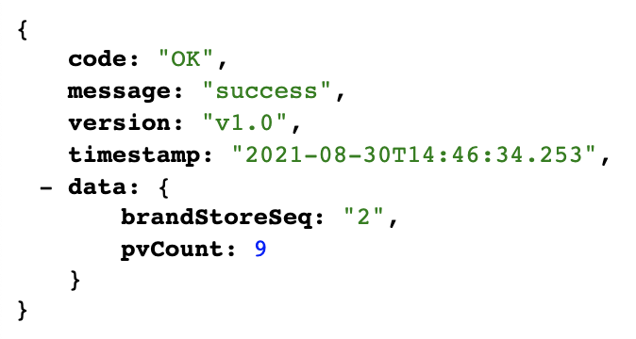
Home (메인 배너)
API: https://front-qa.wemakeprice.com/api/loggtm/statistics/brandstore/{brandStoreSeq}.json
EX: https://front-qa.wemakeprice.com/api/loggtm/statistics/brandstore/2.json
1.
1.

Slide 4
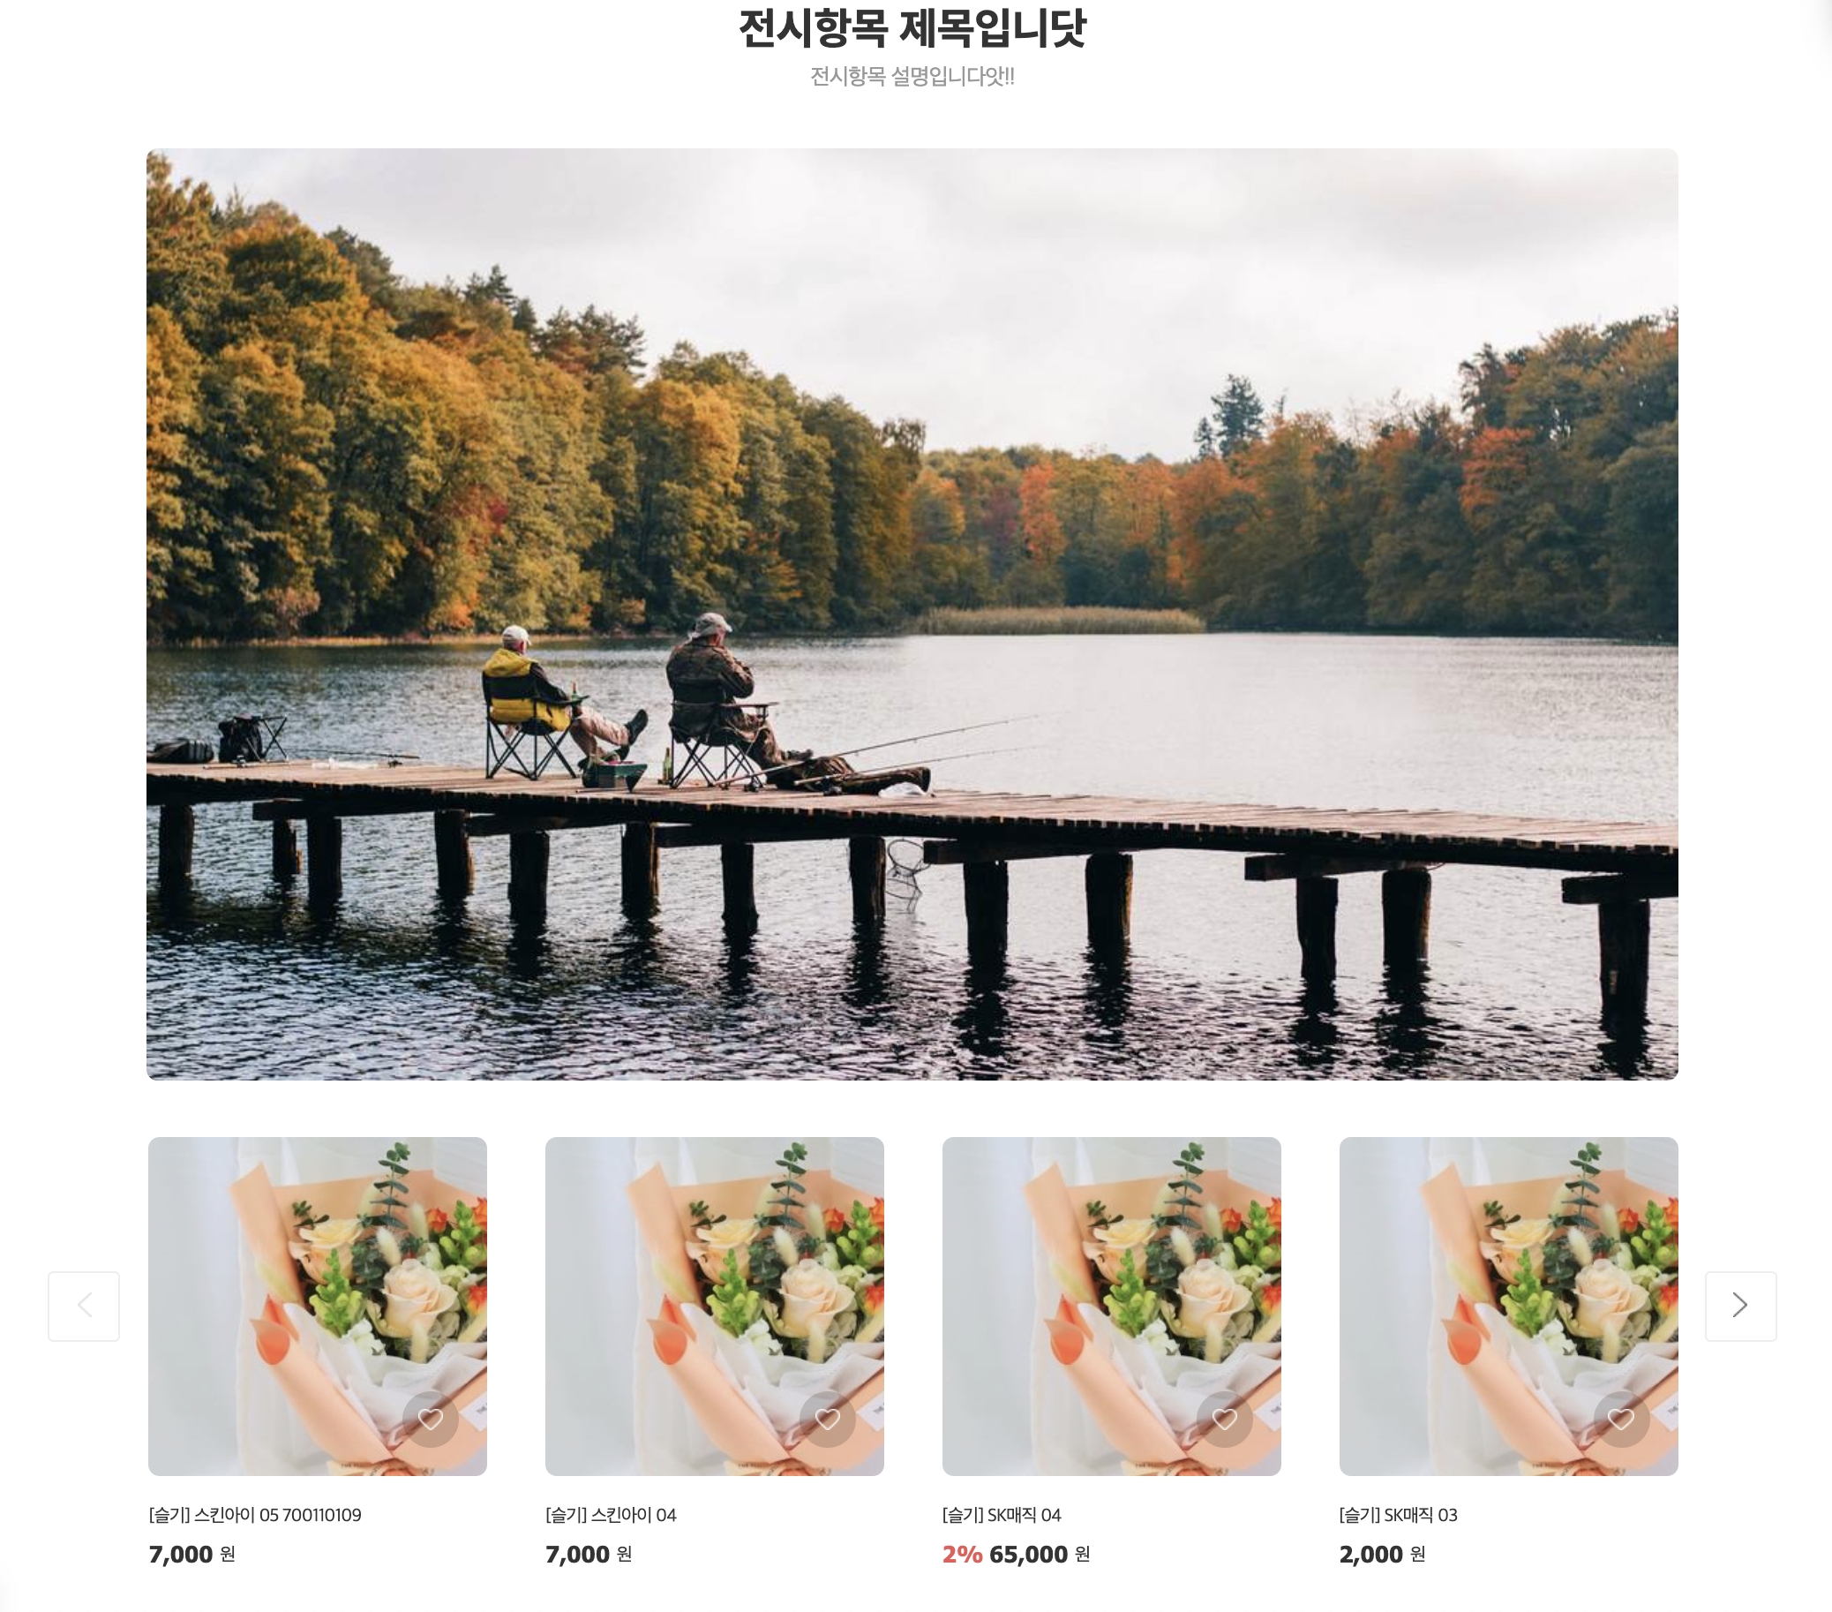
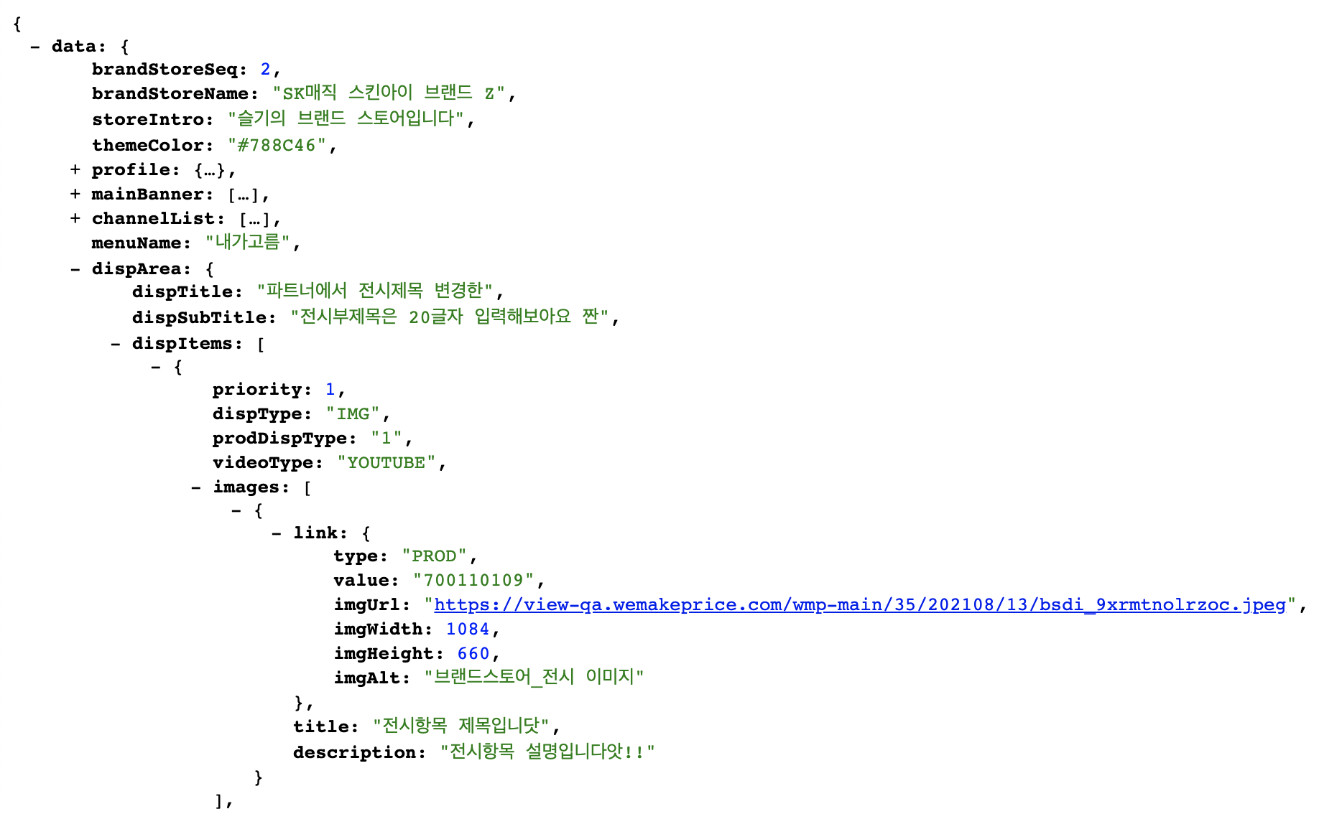
Home (전시영역 – IMG)
API: https://front-qa.wemakeprice.com/api/front/brandStore/main/{brandStoreUrl}.json
EX: https://front-qa.wemakeprice.com/api/front/brandStore/main/brandsk.json
2.
3.
1.
1.
2.
3.

Slide 5
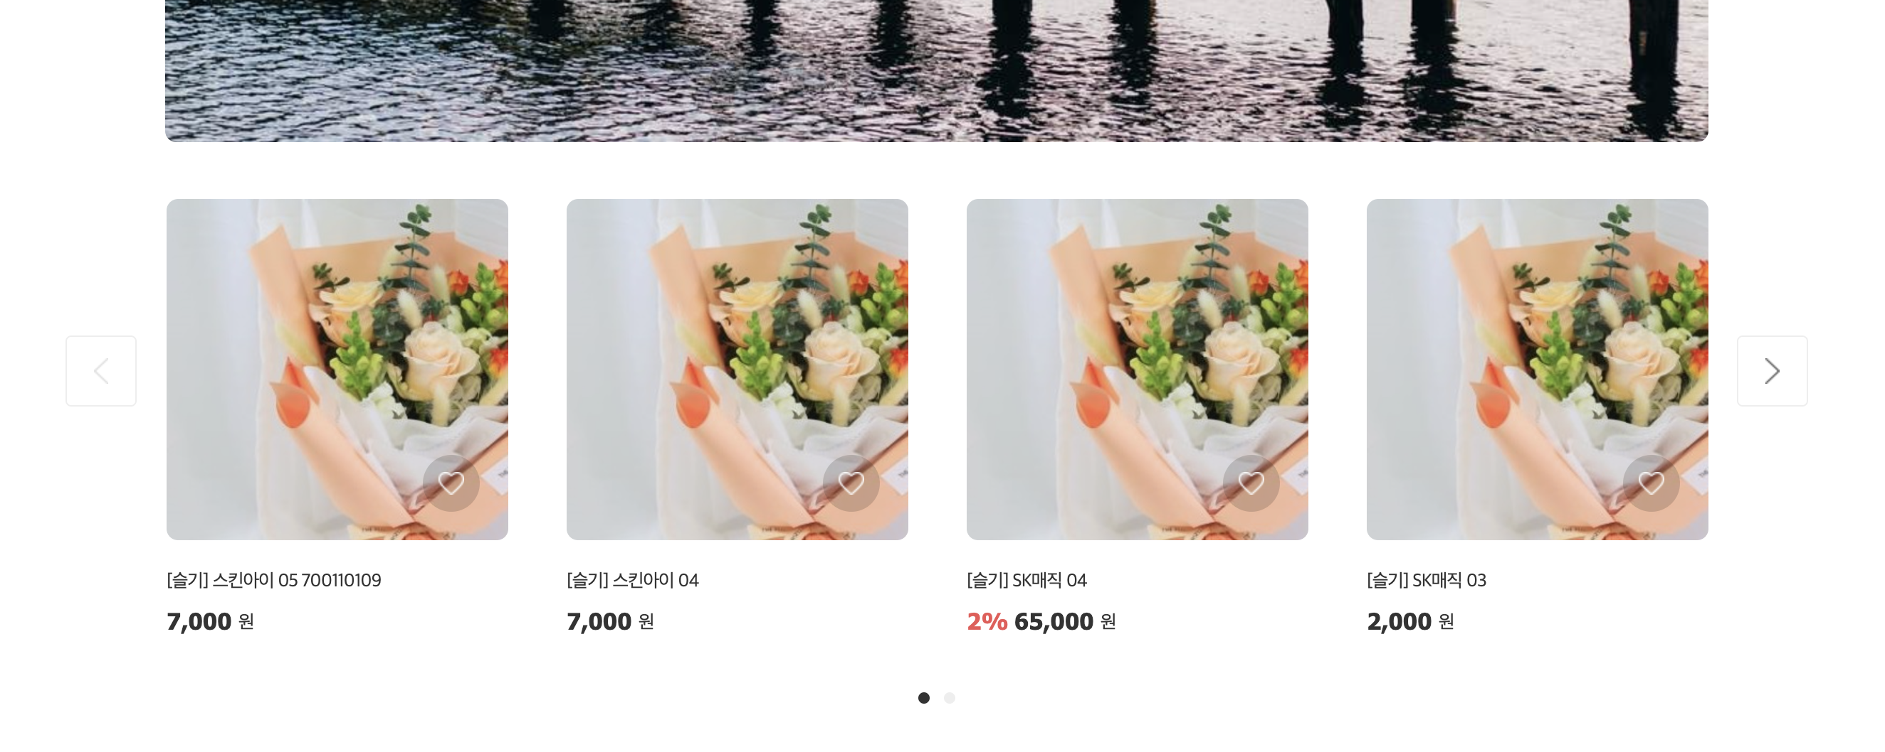
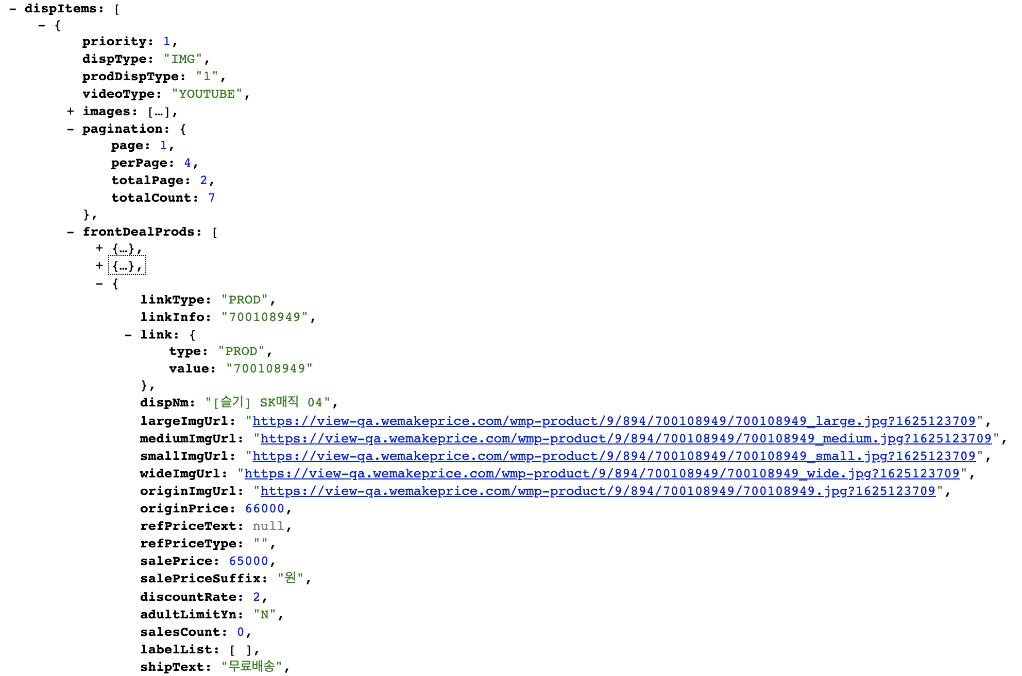
Home (전시영역 – 공통 리스트)
API: https://front-qa.wemakeprice.com/api/front/brandStore/main/{brandStoreUrl}.json
EX: https://front-qa.wemakeprice.com/api/front/brandStore/main/brandsk.json
3.
1.
2.
2.
3.
4.
1.
4.

Slide 6
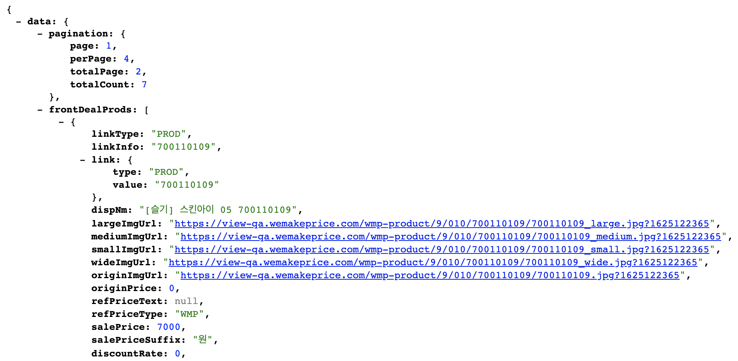
Home (전시영역 – 공통 리스트 페이지 네이션 클릭 시): 공통 리스트와 동일
API: https://front-qa.wemakeprice.com/api/front/brandStore/main/disp/prods/{brandStoreSeq}/{priority}.json?page={page}&perPage={perPage}
EX: https://front-qa.wemakeprice.com/api/front/brandStore/main/disp/prods/2/4.json?page=1&perPage=4

Slide 7
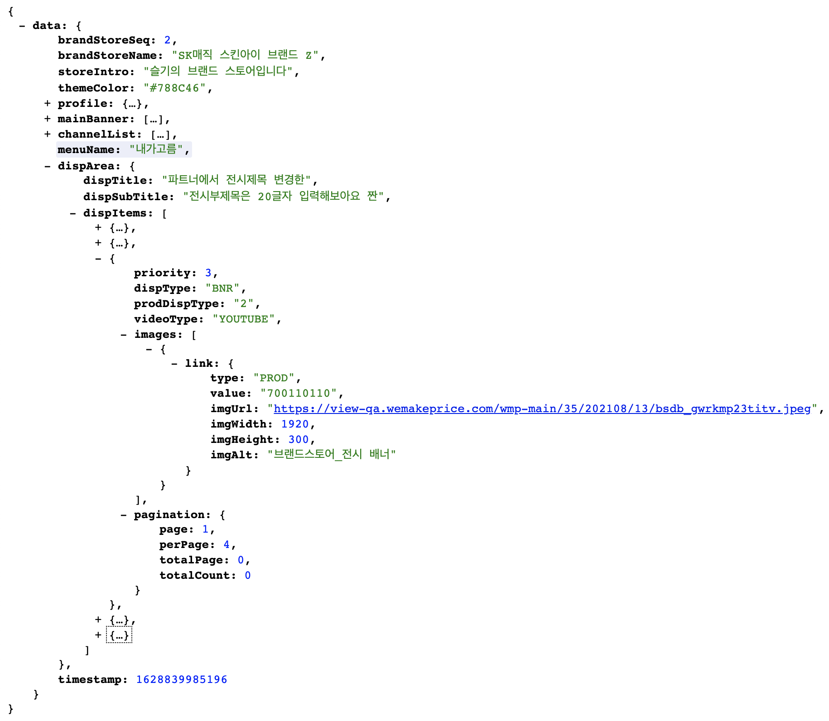

Home (전시영역 – BNR)
API: https://front-qa.wemakeprice.com/api/front/brandStore/main/{brandStoreUrl}.json
EX: https://front-qa.wemakeprice.com/api/front/brandStore/main/brandsk.json
1.
1.

Slide 8
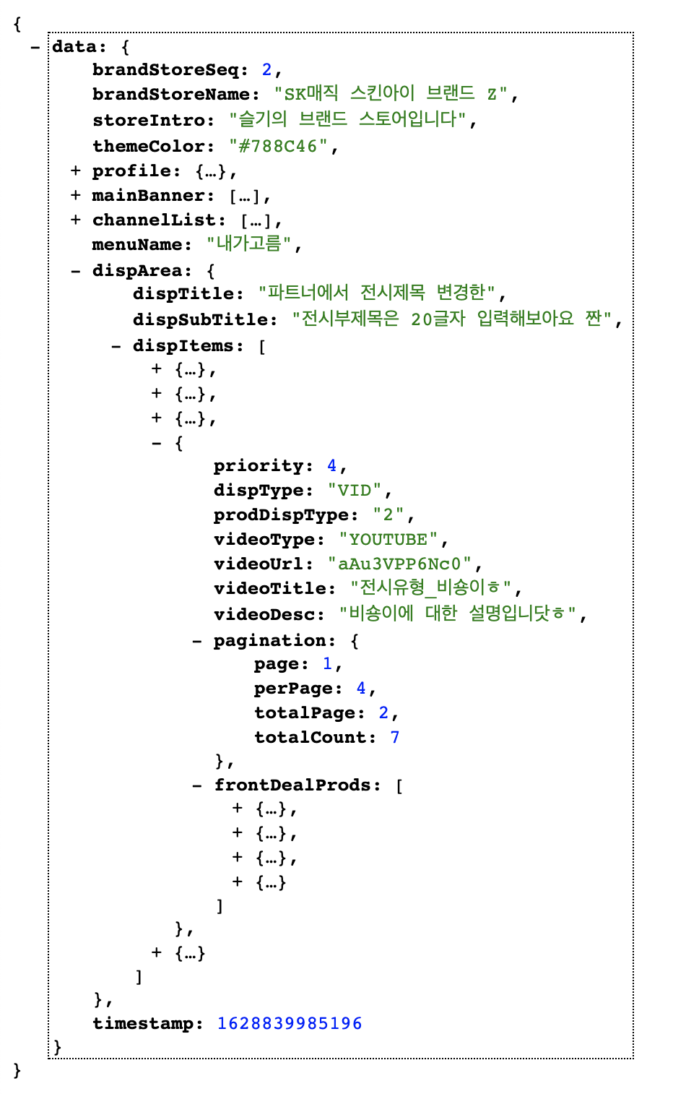
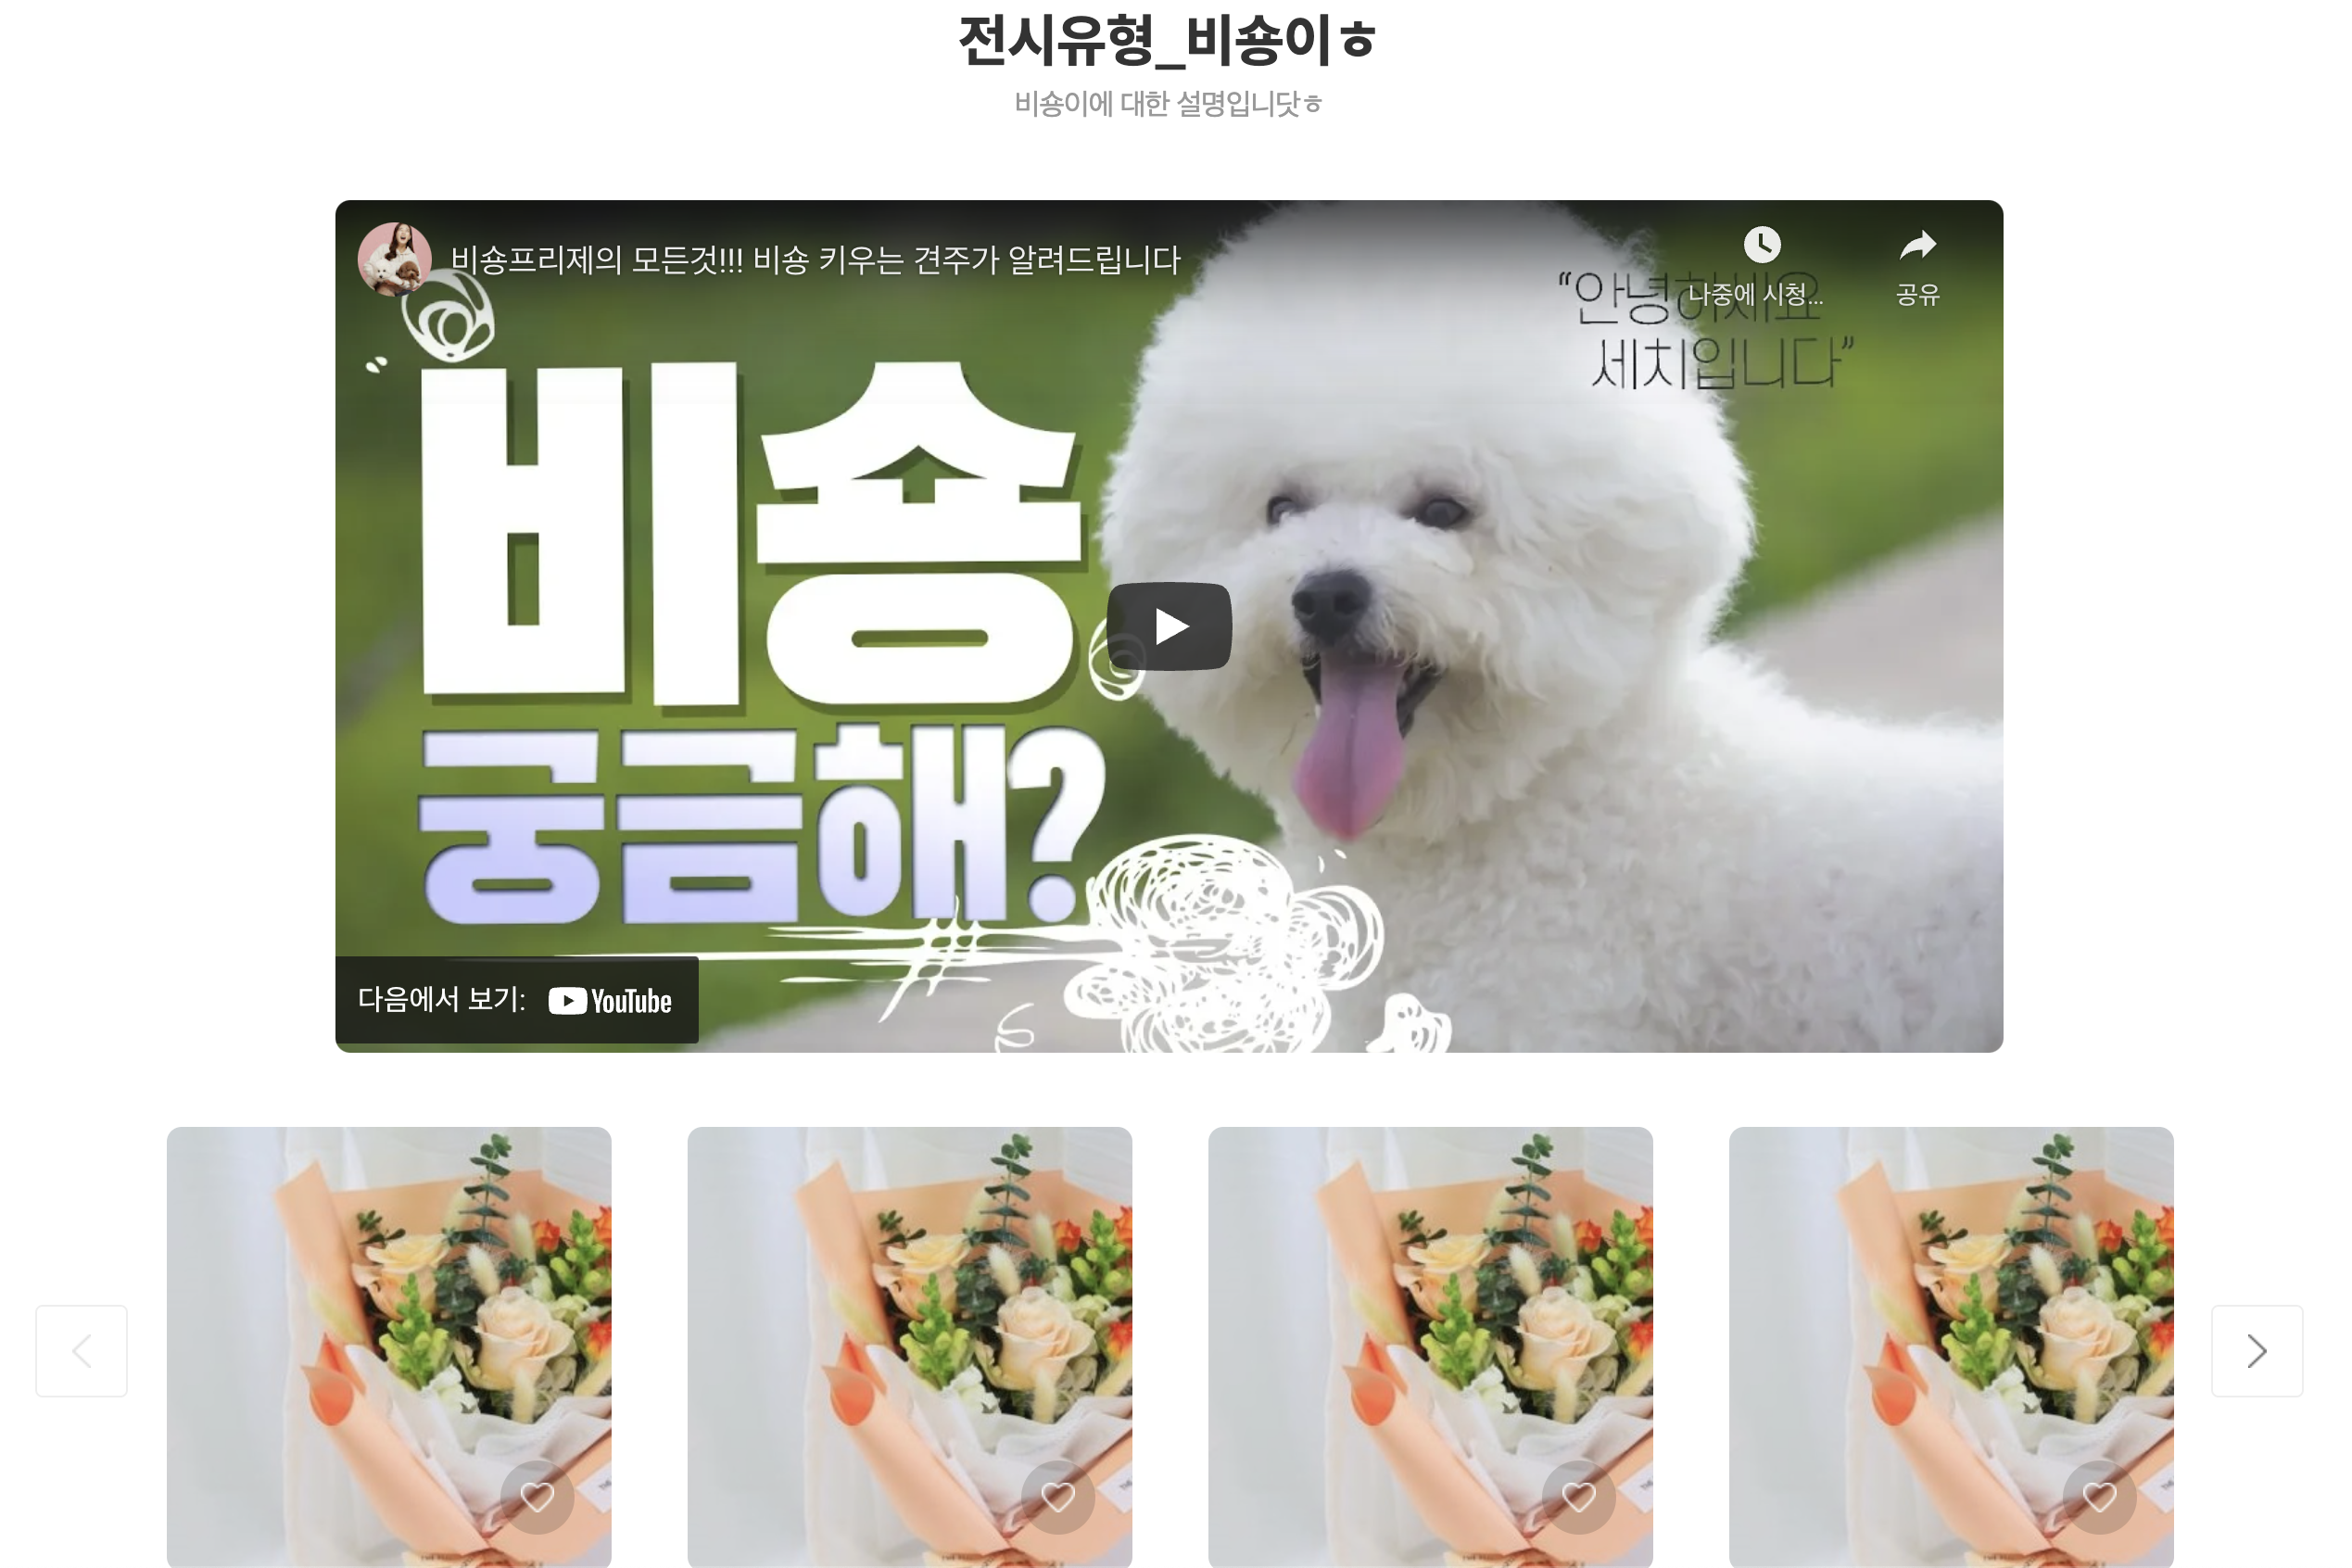
Home (전시영역 – VID)
API: https://front-qa.wemakeprice.com/api/front/brandStore/main/{brandStoreUrl}.json
EX: https://front-qa.wemakeprice.com/api/front/brandStore/main/brandsk.json
2.
1.
1.
2.

Slide 9
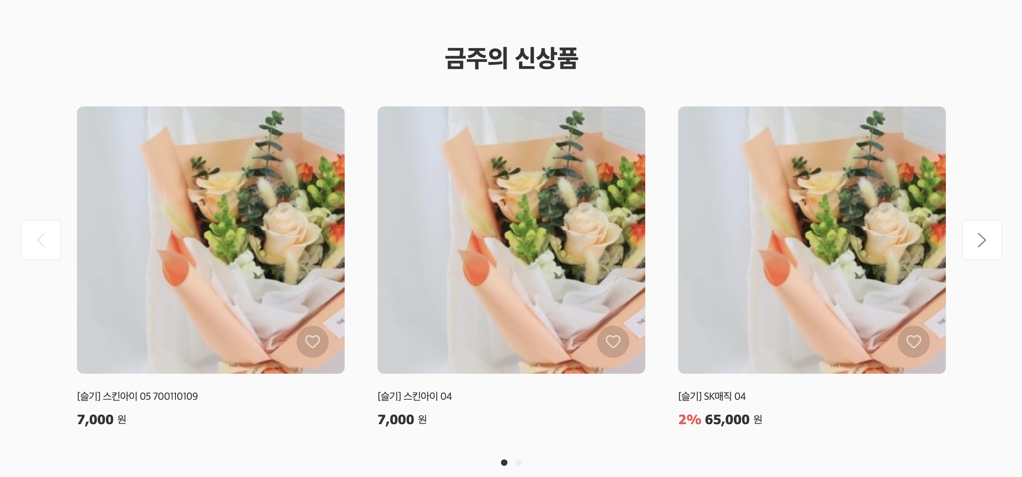
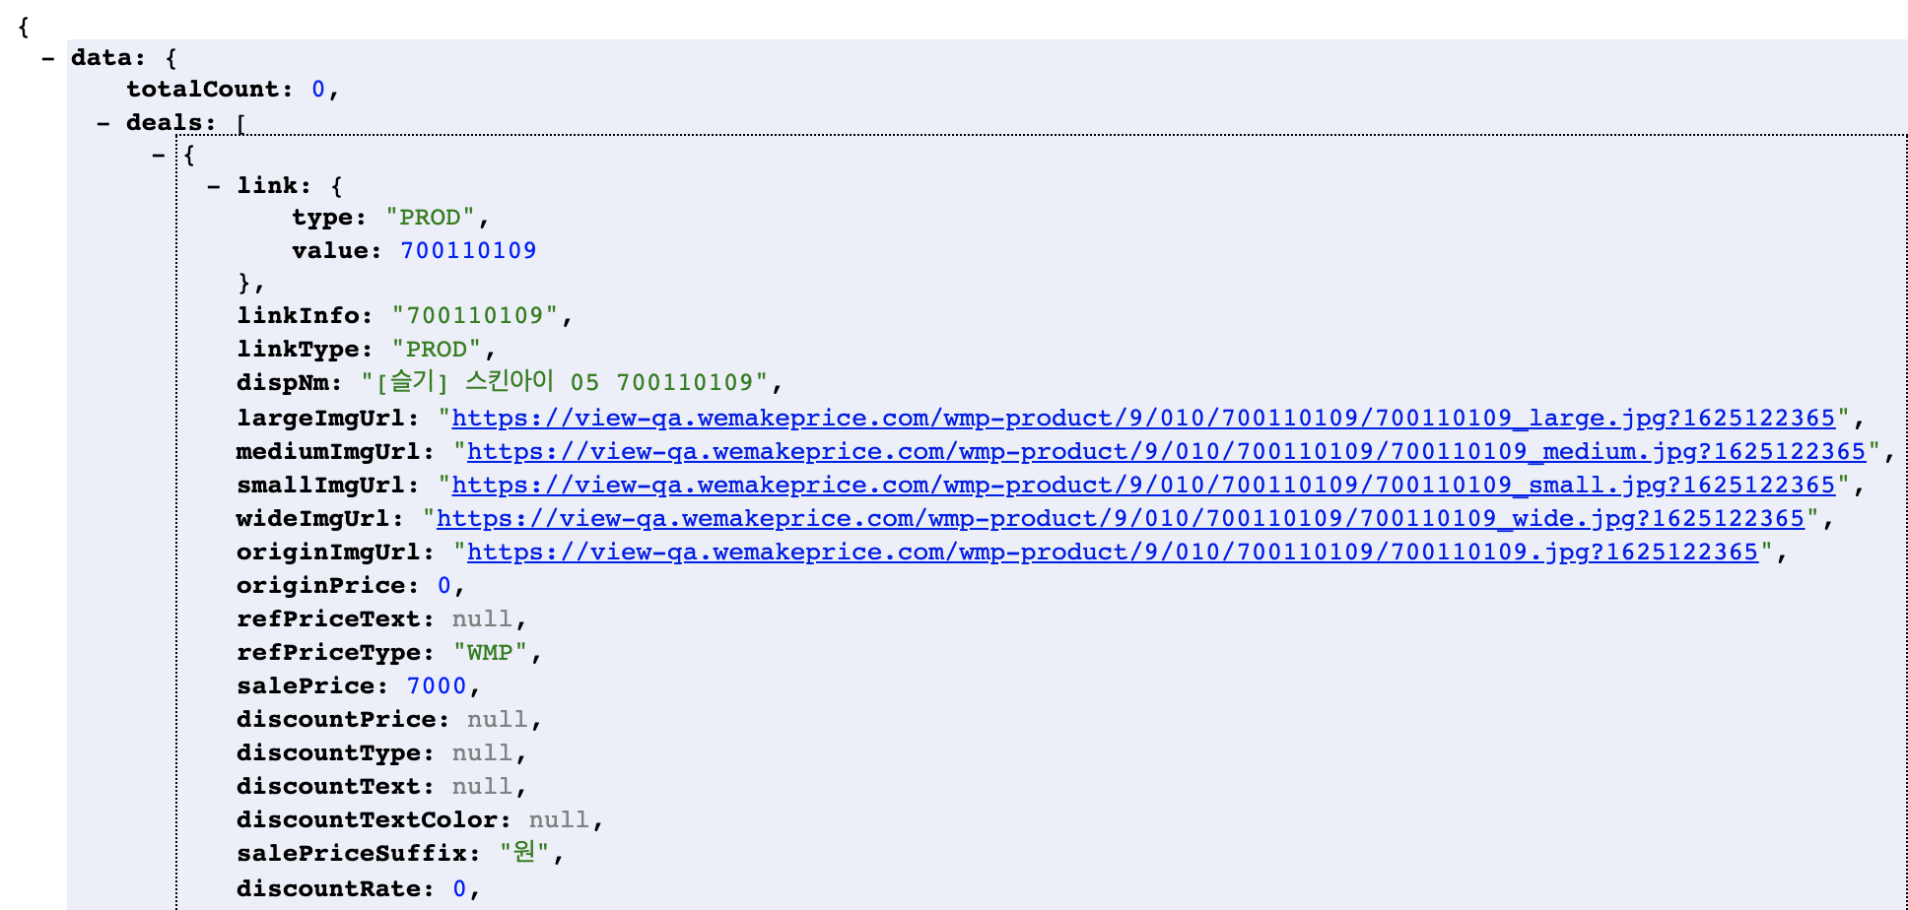
Home (금주의 신상품): 공통 리스트와 동일
API: https://front-qa.wemakeprice.com/api/listingsearch/v1.0/brandStore/newList.json?page={page}&brandStoreSeq={brandStoreSeq}&perPage={perPage}&totalPage=4
EX: https://front-qa.wemakeprice.com/api/listingsearch/v1.0/brandStore/newList.json?page=1&brandStoreSeq=2&perPage=3&totalPage=4

Slide 10
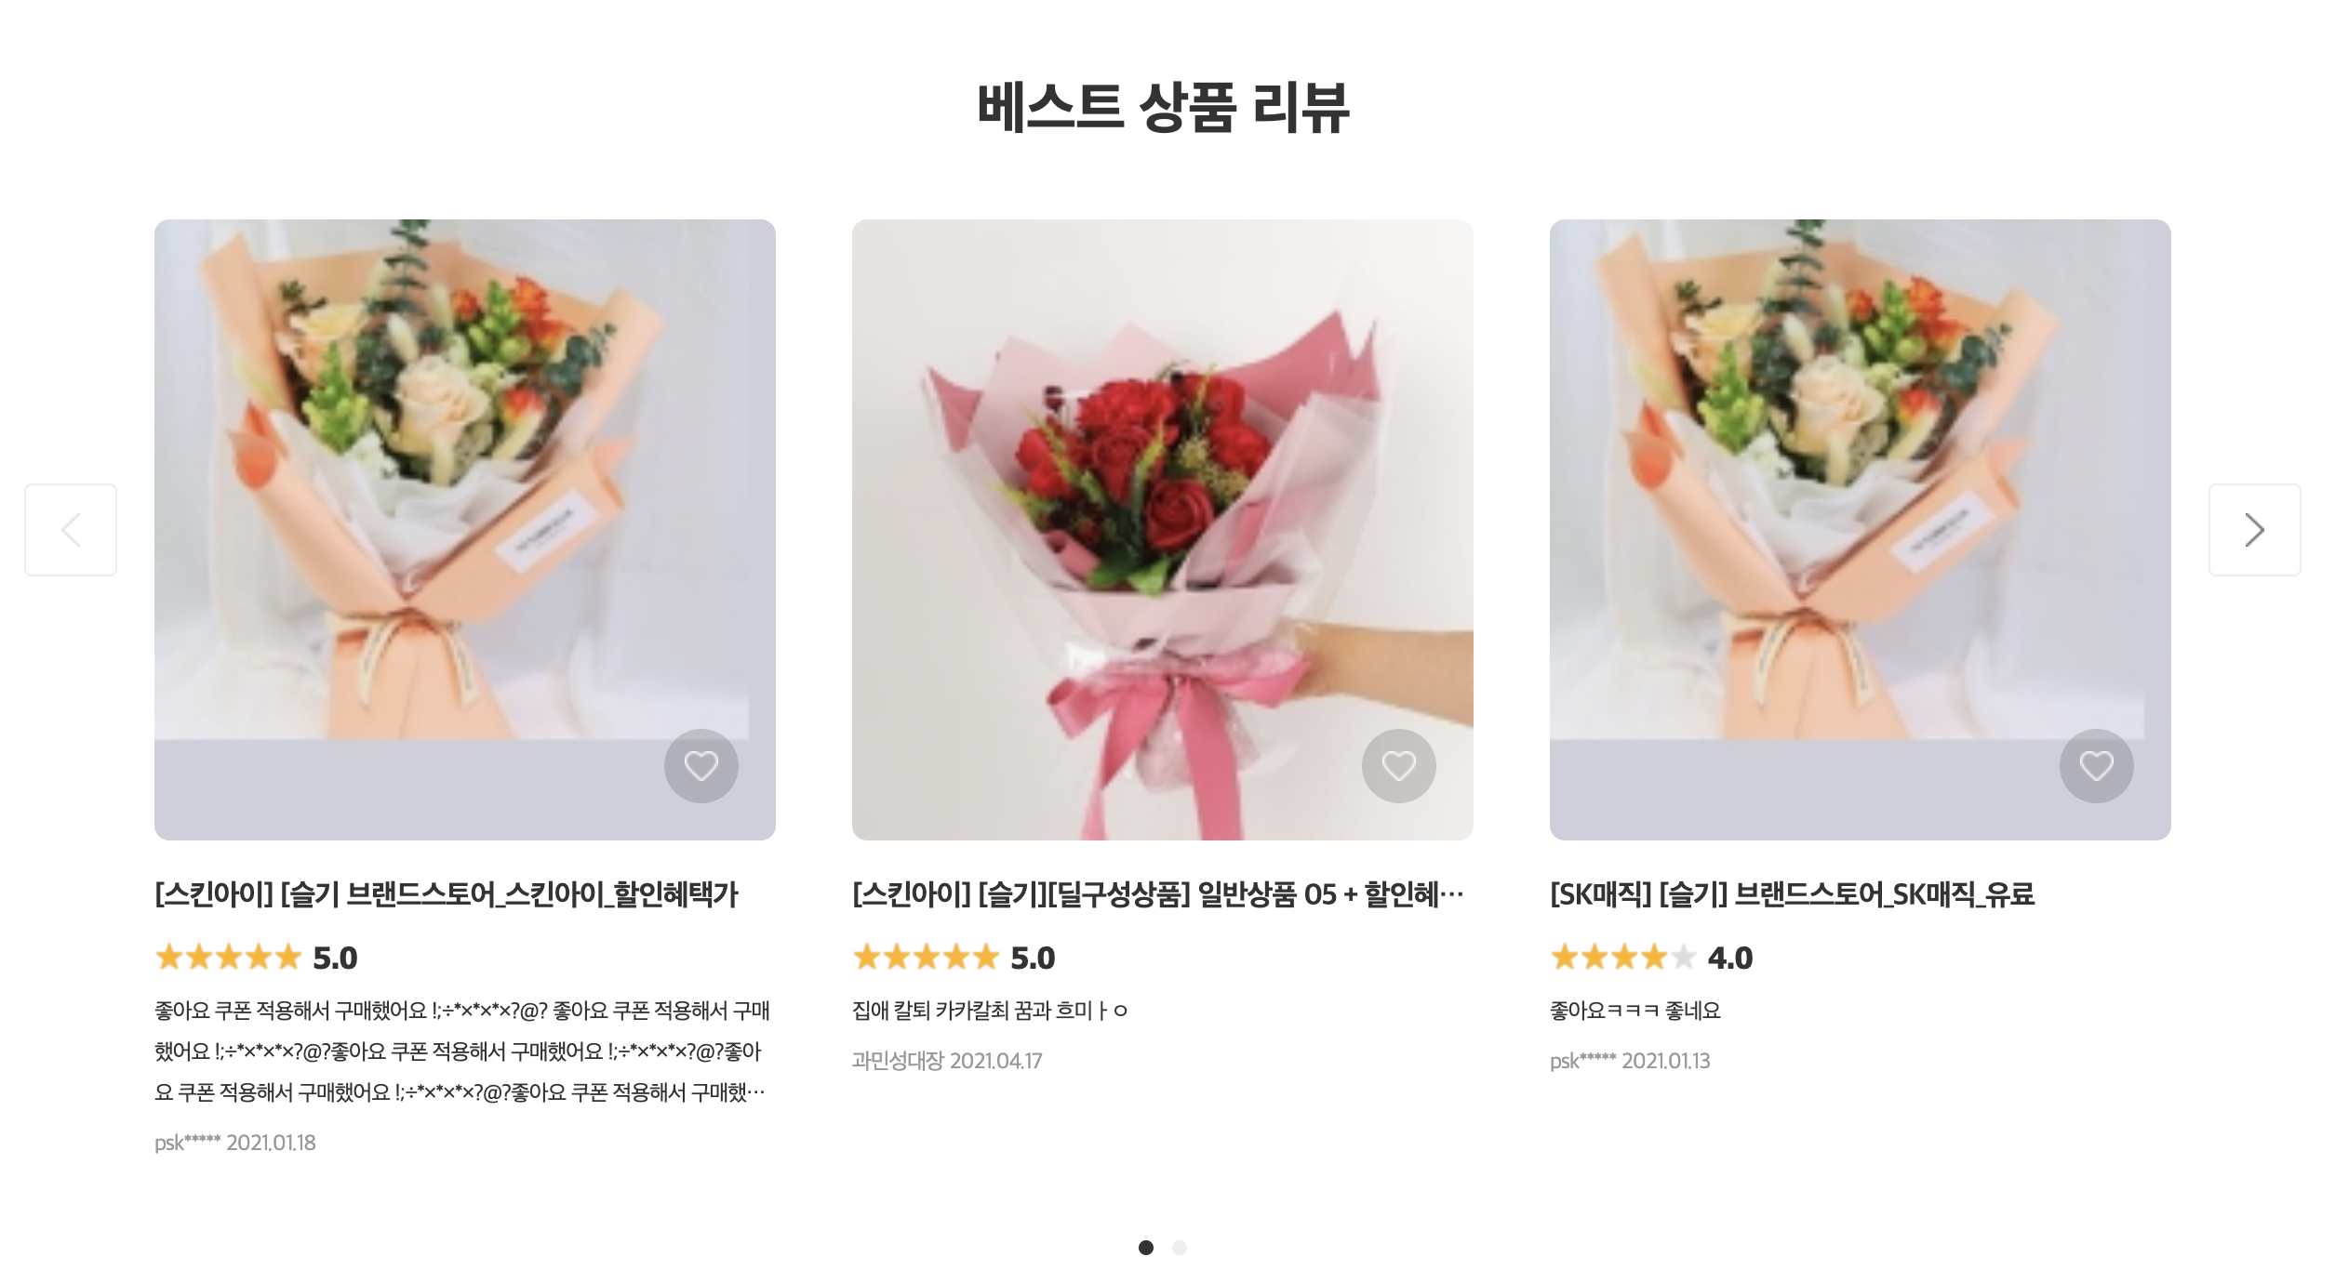
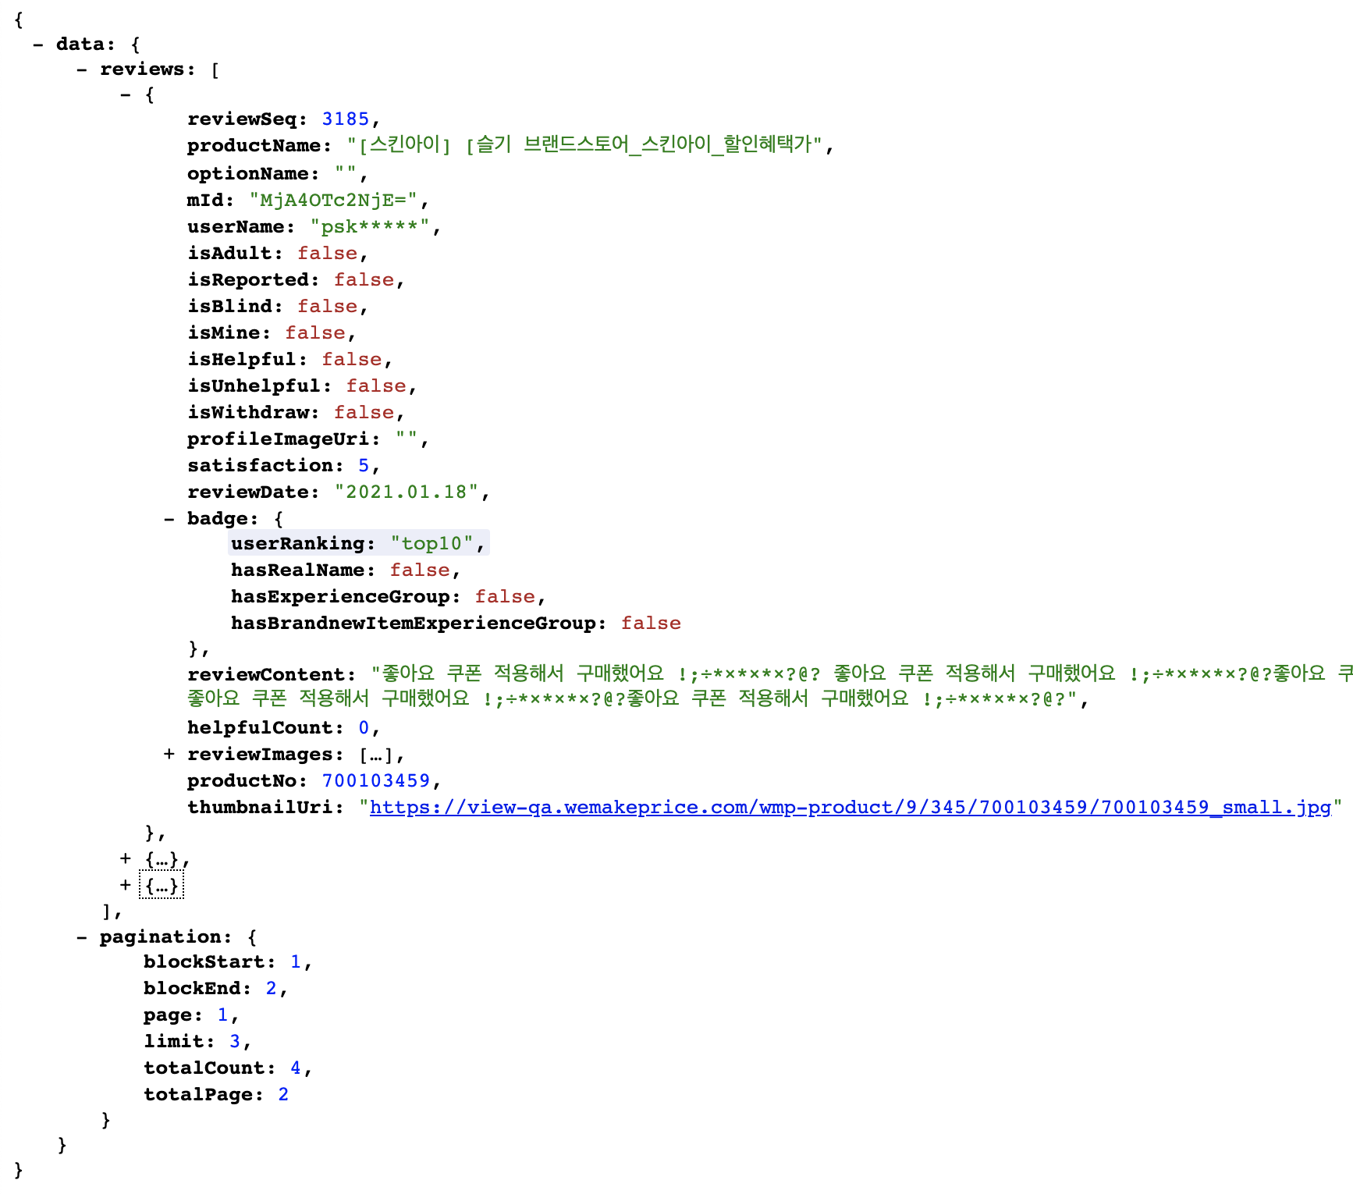
Home (베스트 상품 리뷰)
API: https://front-qa.wemakeprice.com/api/review/brandStore/v2.3/{brandStoreSeq}/review/best.json?page={page}&limit={limit}
EX: https://front-qa.wemakeprice.com/api/review/brandStore/v2.3/2/review/best.json?page=1&limit=3
5.
1.
2.
3.
4.
2.
5.
4.
1.
6.
3.
6.

Slide 11
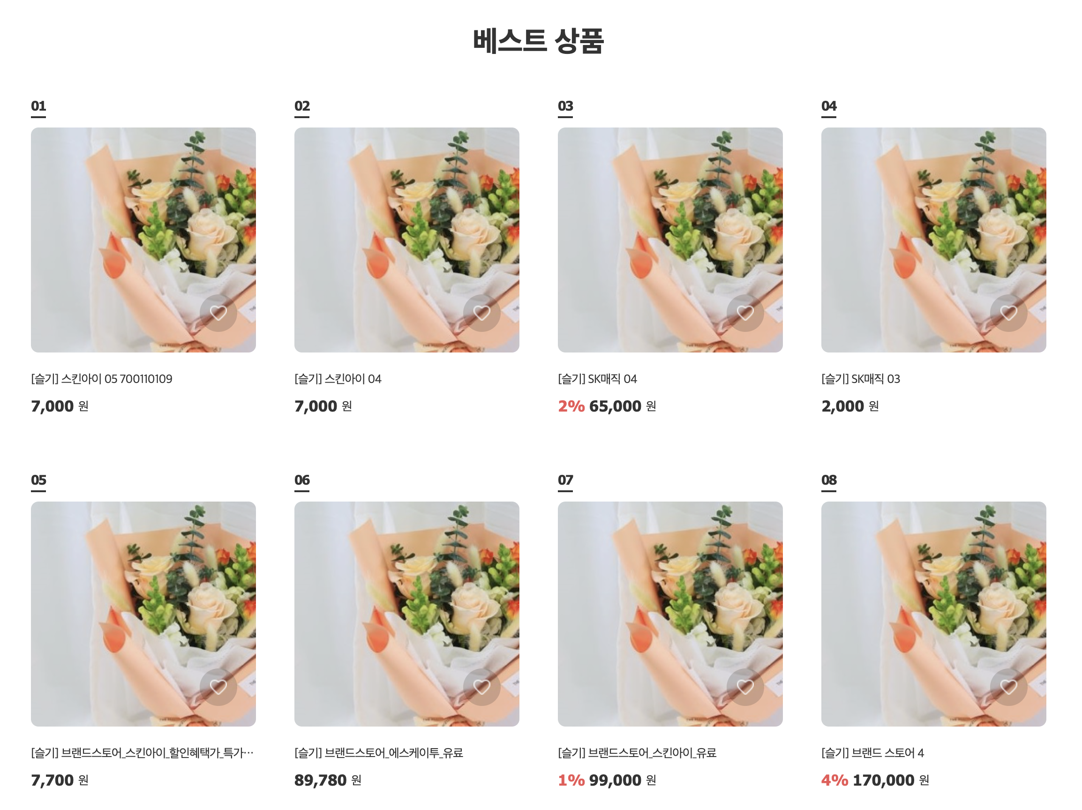
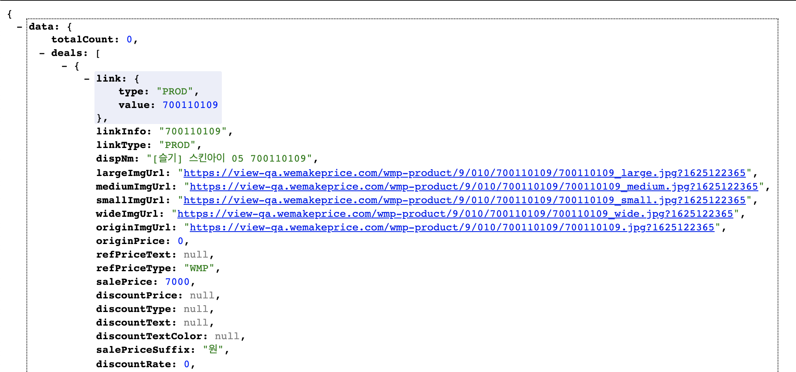
Home (베스트 상품): 공통 리스트와 동일
API: https://front-qa.wemakeprice.com/api/listingsearch/v1.0/brandStore/best.json?page={page}&brandStoreSeq={brandStoreSeq}&perPage={perPage}&os=pc
EX: https://front-qa.wemakeprice.com/api/listingsearch/v1.0/brandStore/best.json?page=1&brandStoreSeq=2&perPage=8&os=pc

Slide 12
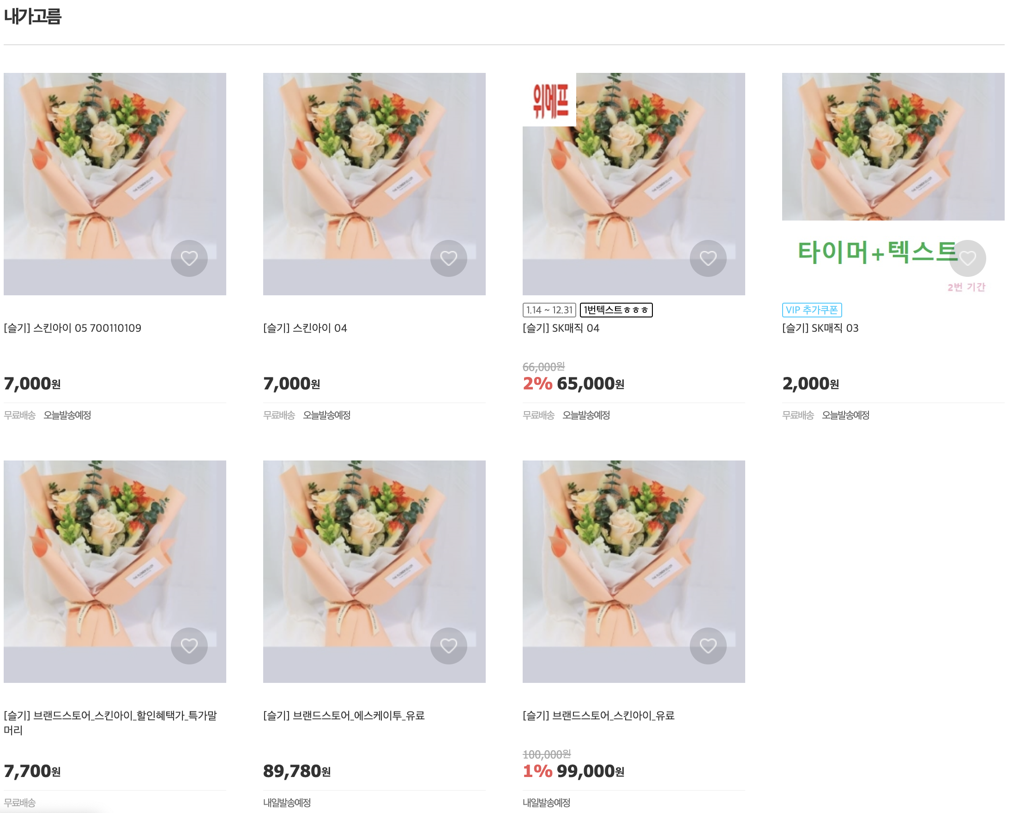
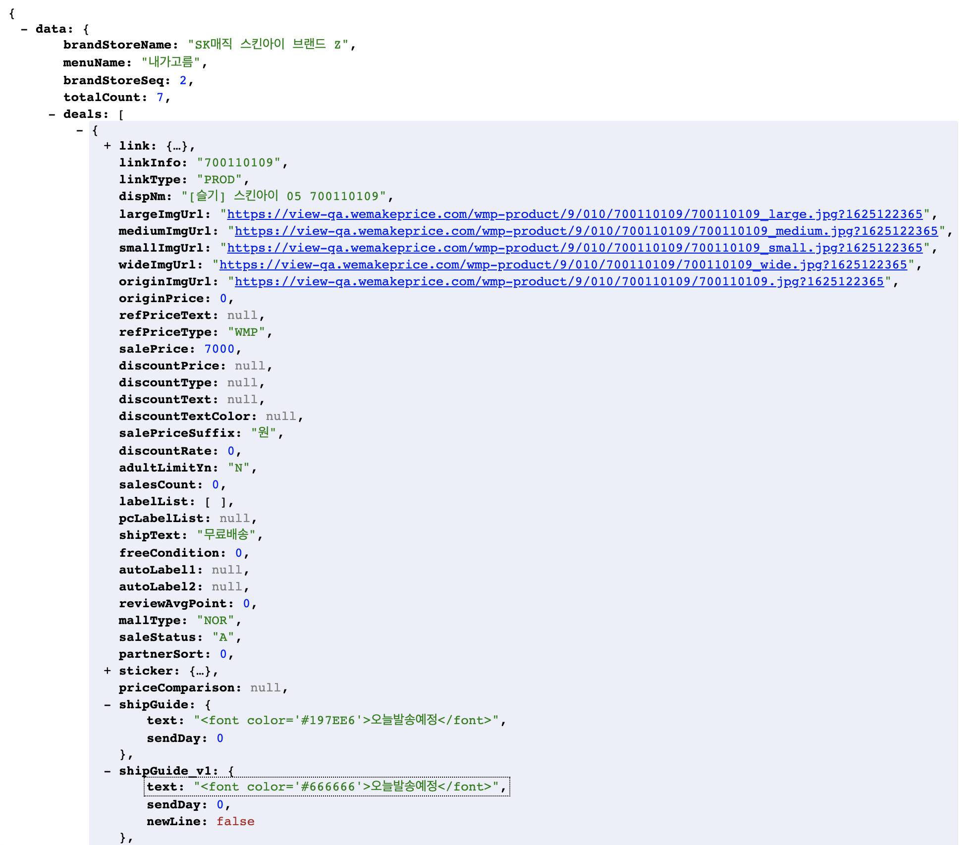
Special
API: https://front-qa.wemakeprice.com/api/listingsearch/v1.0/brandStore/specialList.json?url={brandStoreUrl}&page={page}&perPage={perPage}&os=pc
EX: https://front-qa.wemakeprice.com/api/listingsearch/v1.0/brandStore/specialList.json?url=brandsk&page=1&perPage=24&os=pc
2.
1.
2.
1.
3.
3.
4.
5.
4.
5.

Slide 13
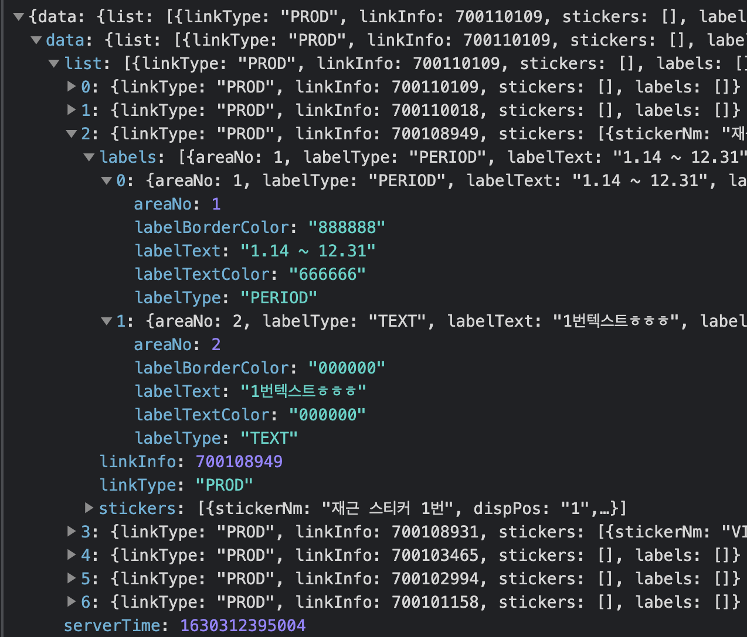
Special (스티커)
API: (POST) https://front-qa.wemakeprice.com/api/sticker/sticker/v2/linkInfos.json (BODY) {"links":[{"type":"PROD","value":700110109},{"type":"PROD","value":700110018},{"type":"PROD","value":700108949},{"type":"PROD","value":700108931}, {"type":"PROD","value":700103465},{"type":"PROD","value":700102994},{"type":"PROD","value":700101158}]}

Slide 14
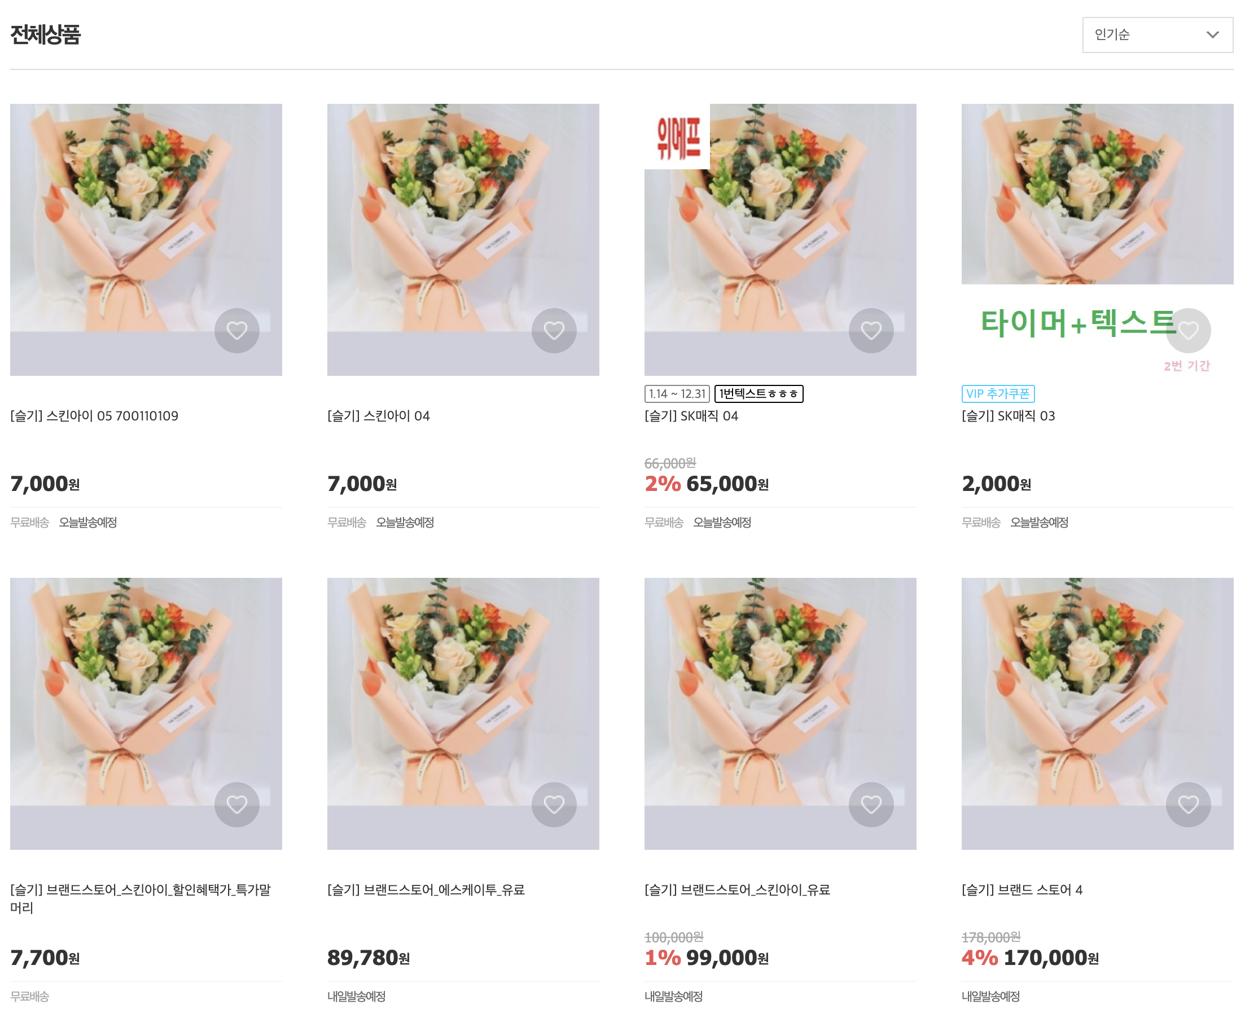
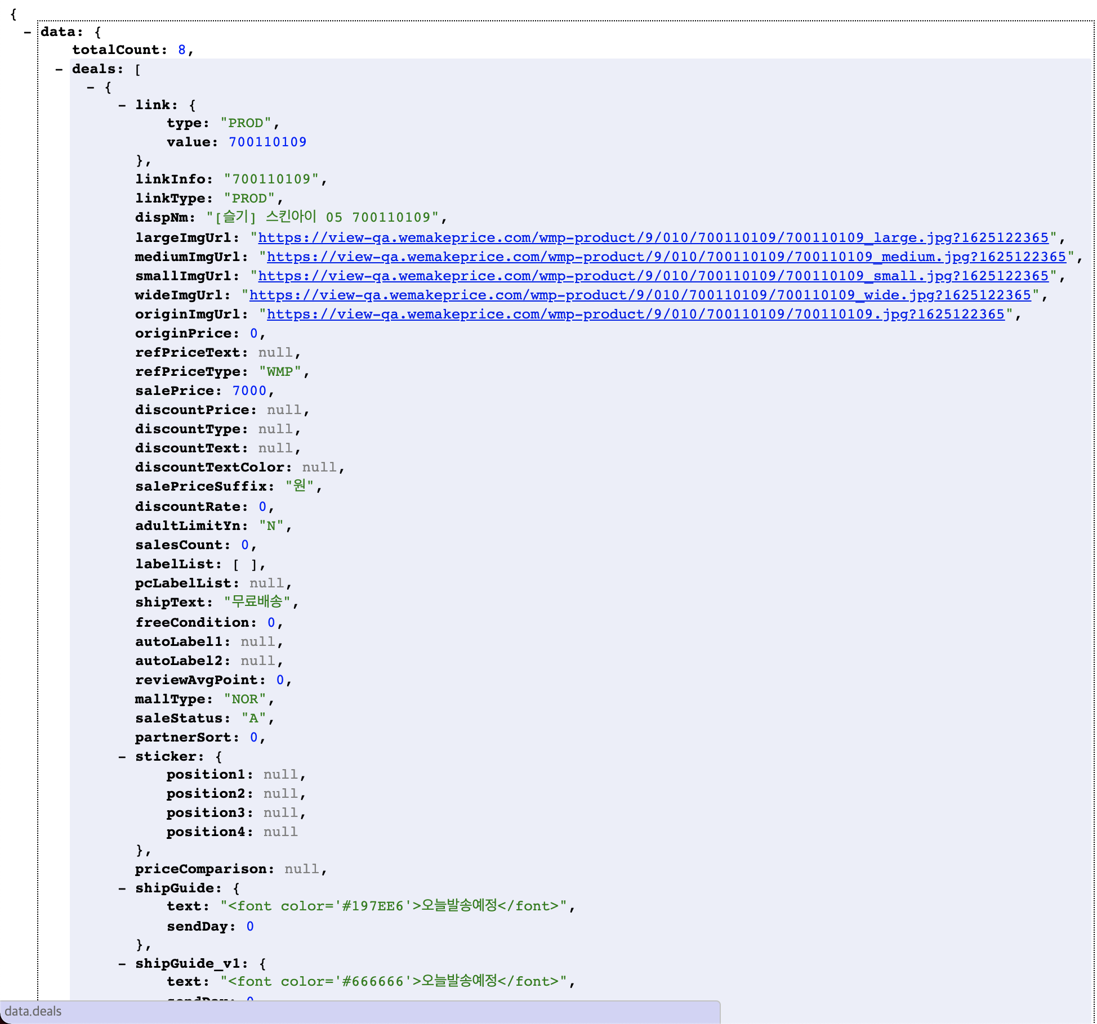
Category, Category 스티커: Special과 동일
API: https://front-qa.wemakeprice.com/api/listingsearch/v1.0/brandStore/categoryList.json?brandStoreSeq={brandStoreSeq}&os=pc&page={page}&sort={sort}
EX: https://front-qa.wemakeprice.com/api/listingsearch/v1.0/brandStore/categoryList.json?brandStoreSeq=2&cateCode=&os=pc&page=1&sort=favorite

Slide 15
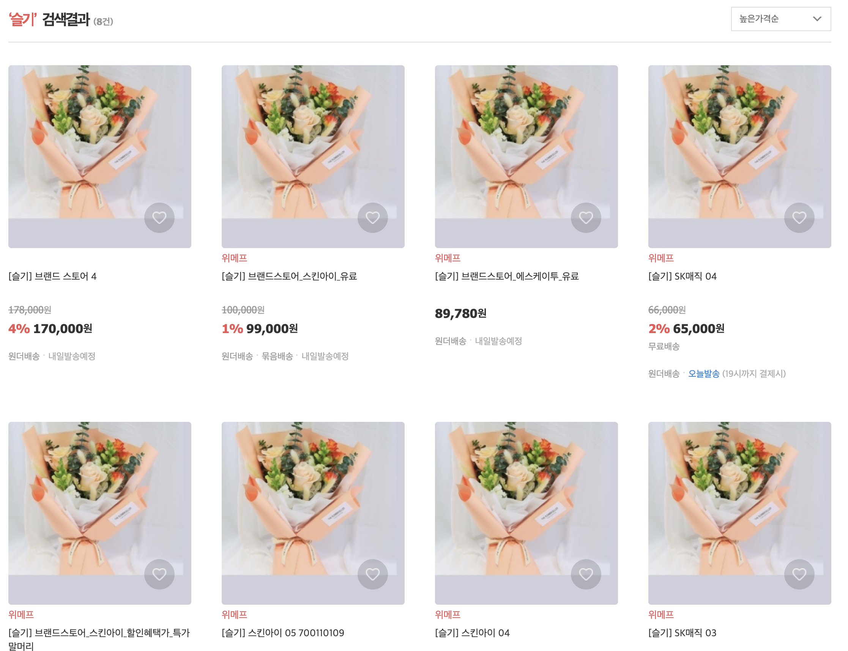
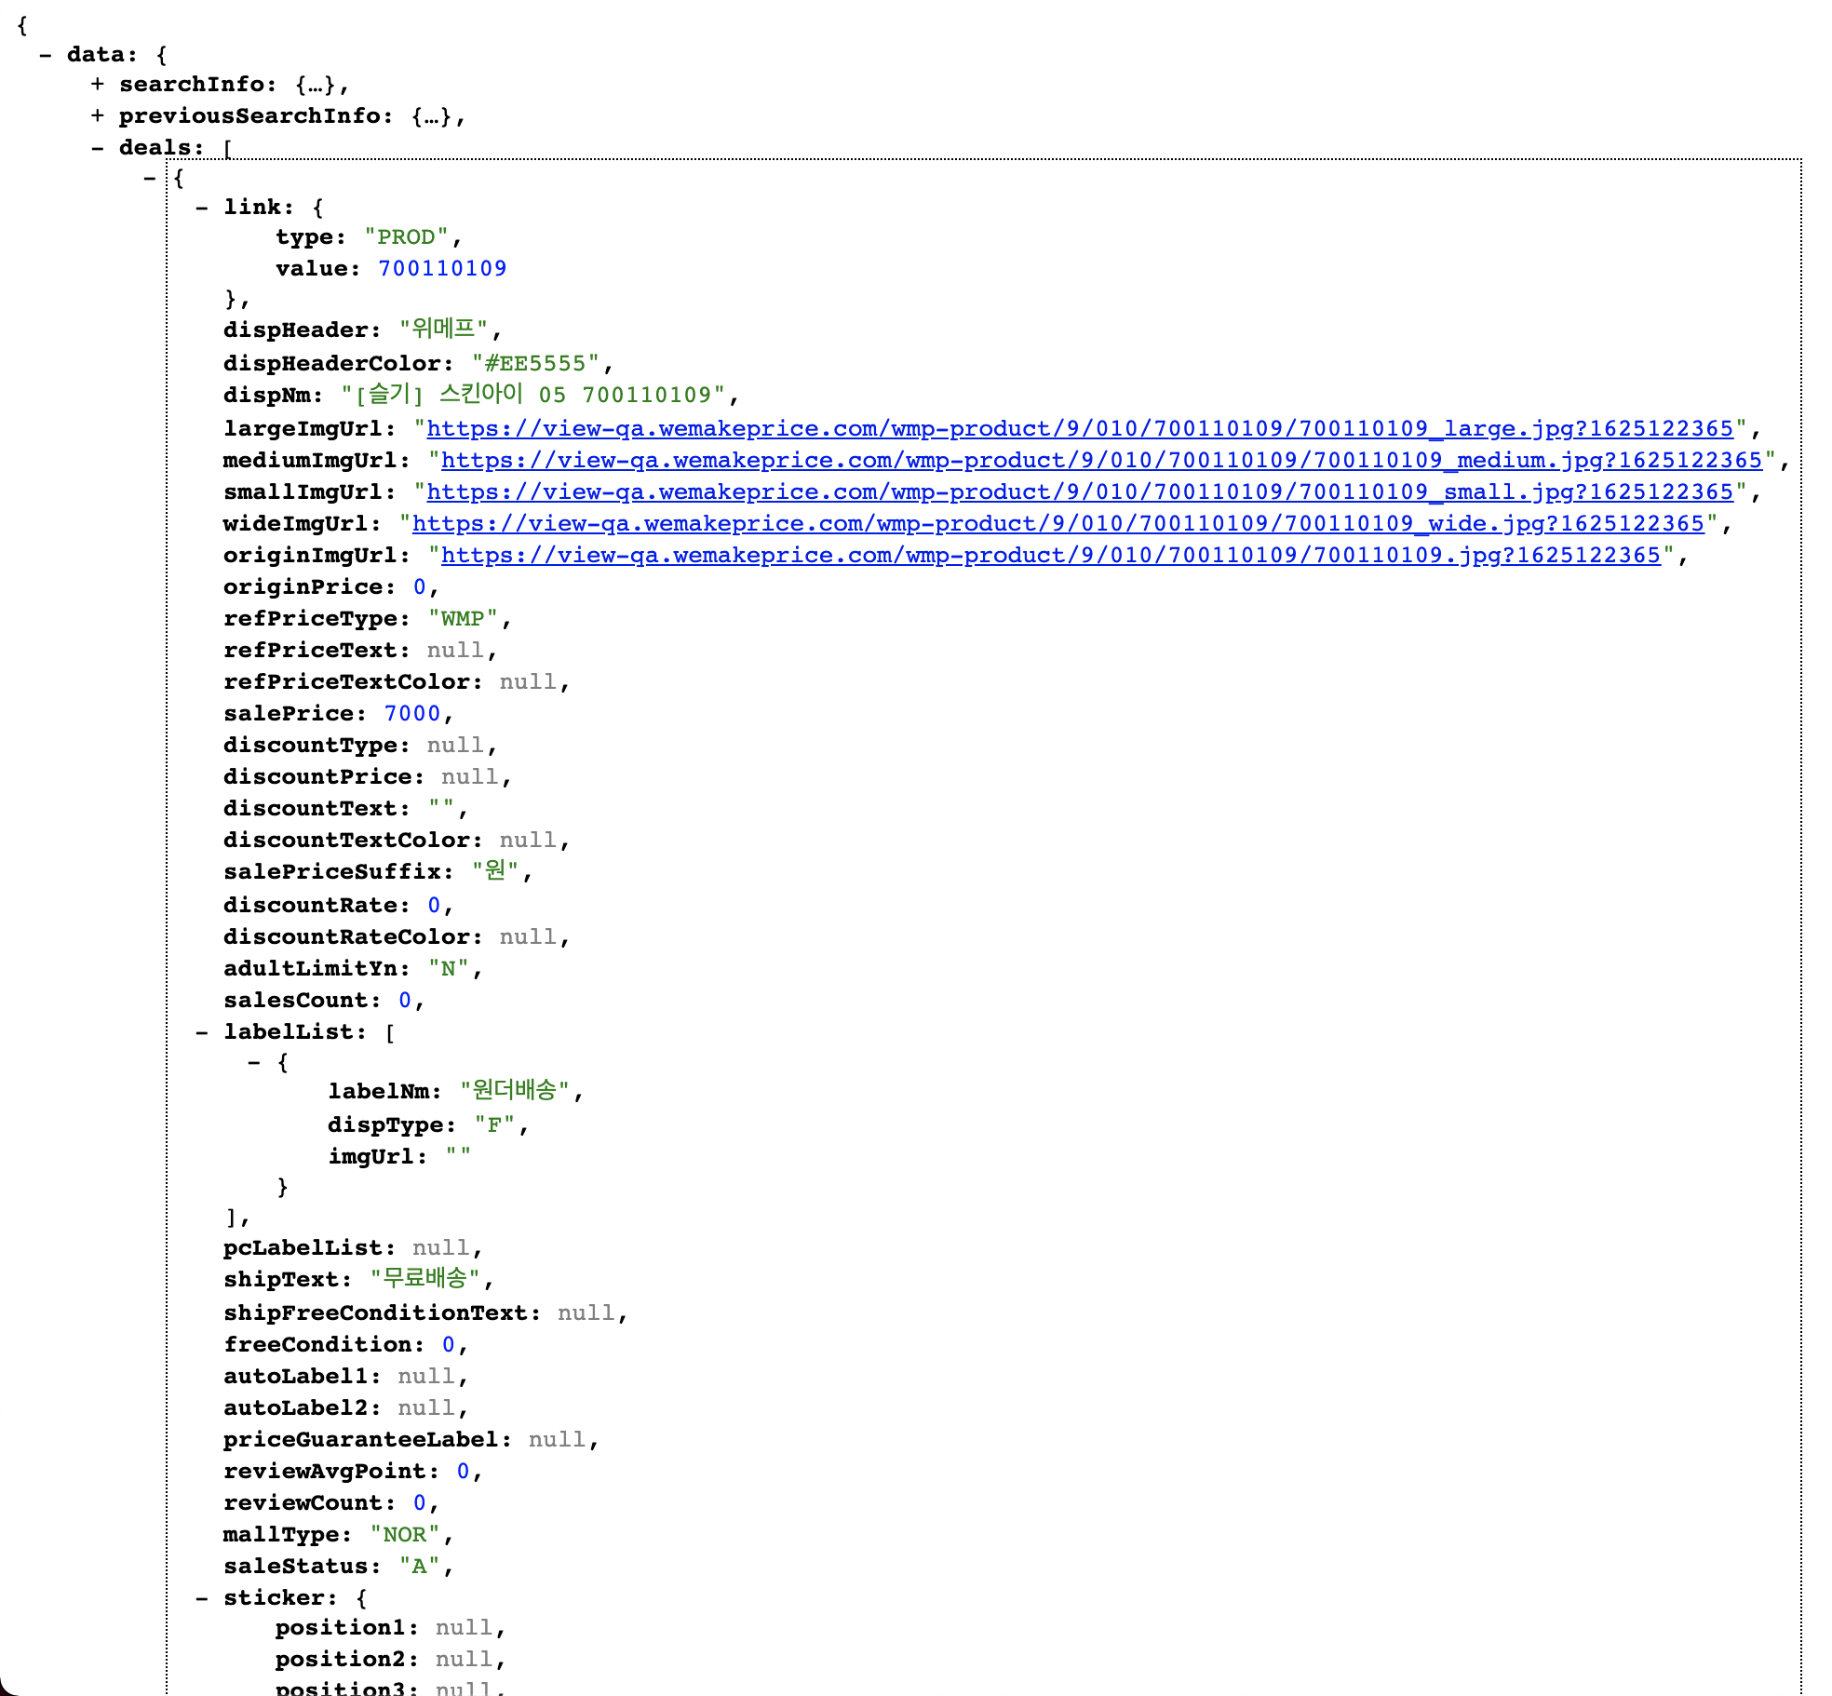
Search, Search 스티커: Special과 동일
API: https://front-qa.wemakeprice.com/api/wmpsearch/api/v1.0/brand-store/search/inner?os=pc&perPage={perPage} &keyword={keyword}&brandStoreSeq={brandStoreSeq}&sort={sort}
EX: https://front-qa.wemakeprice.com/api/wmpsearch/api/v1.0/brand-store/search/inner?os=pc&perPage=40&keyword=슬기&brandStoreSeq=2&sort=expensive

